Slide 1
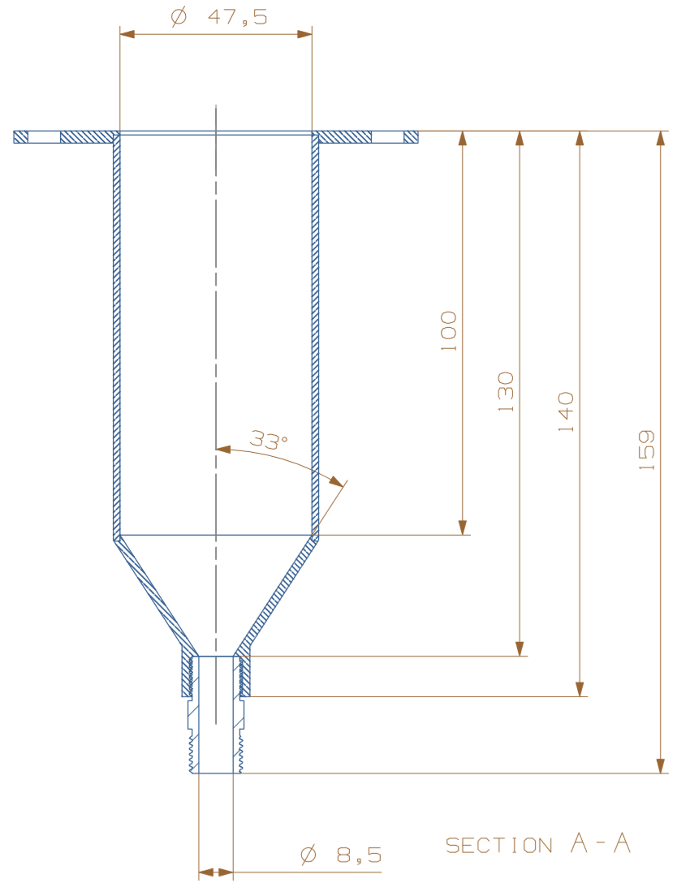
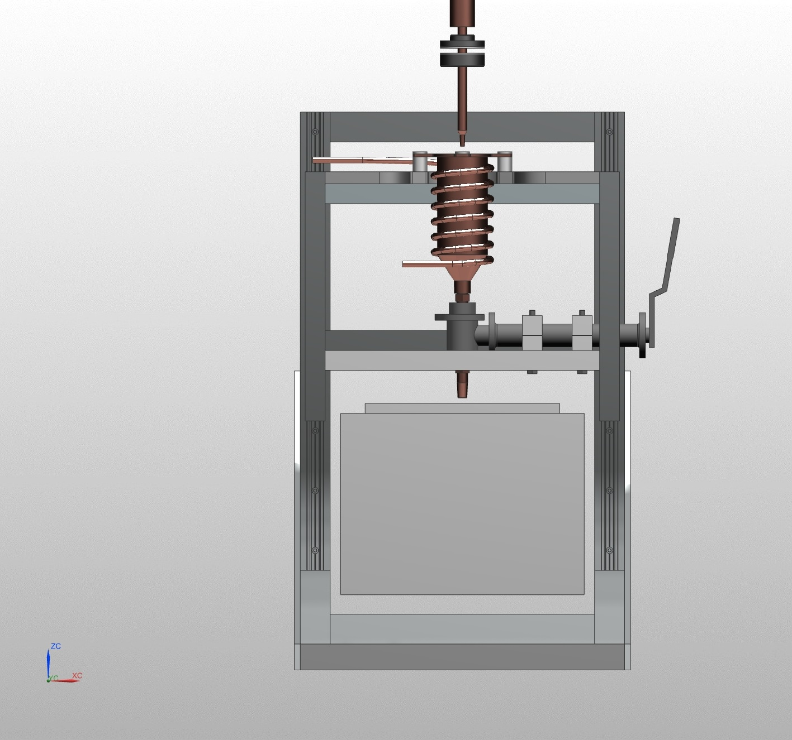
a)
b)
Tc 3
Tc A
Tc 2
Tc B
Tc 1
Tc 4

Slide 2
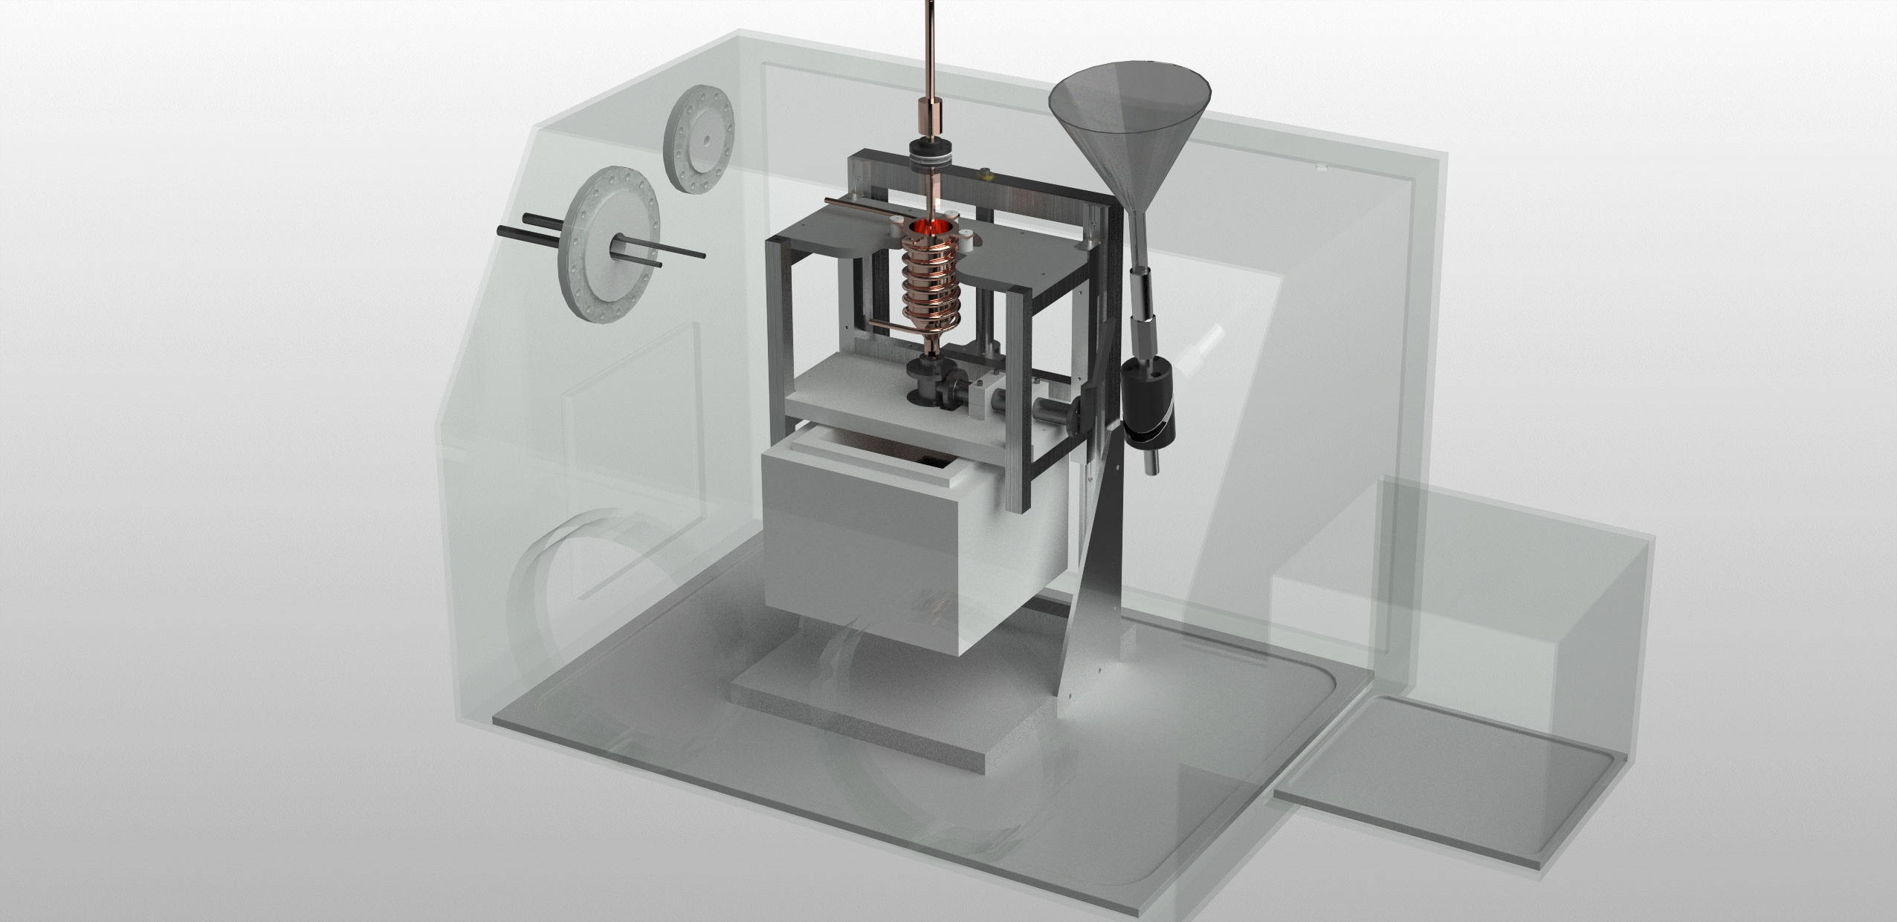
5*
4
8
3
2
1
6
7

Slide 3
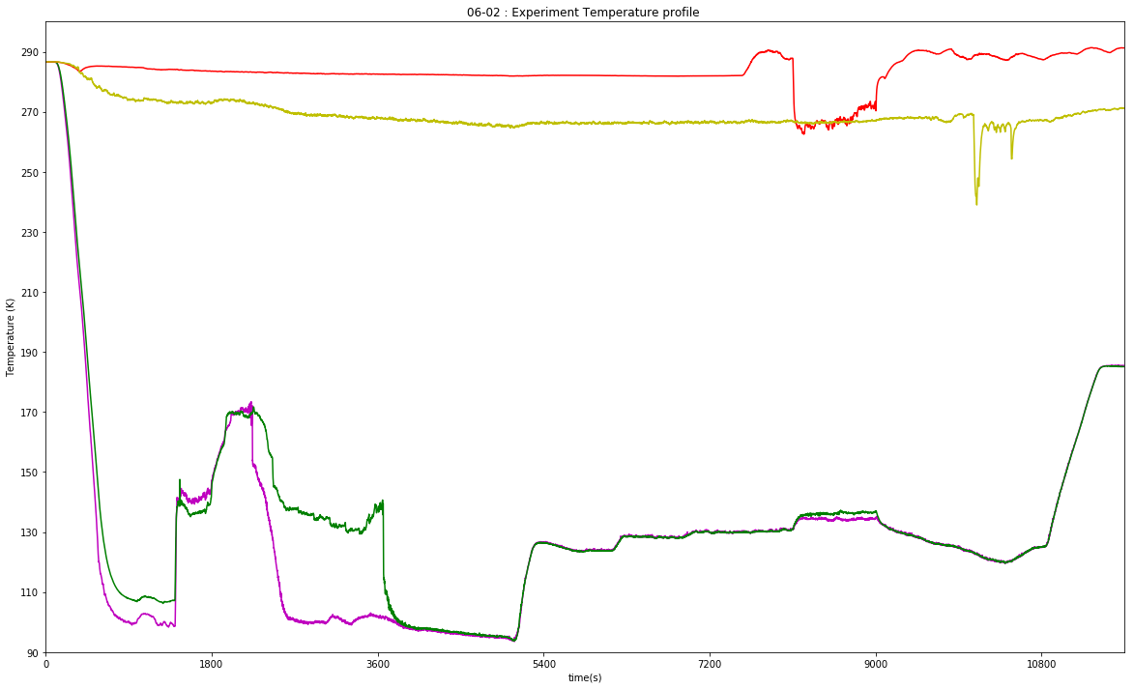
I
II
III
IV
V
VI
VII
Tc 1 Ethane bottom
Tc 2 Ethane top
Tc 3 Nozzle
Tc 4 Flying

Slide 4
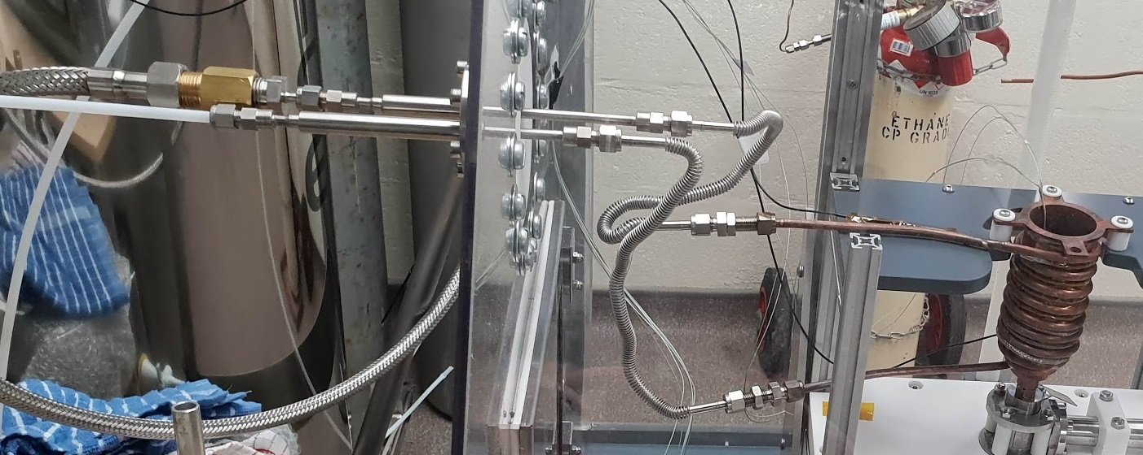
a
b
c
d
Inlet Liquid N₂
Outlet (cold gas)
h
f
g
e

Slide 5
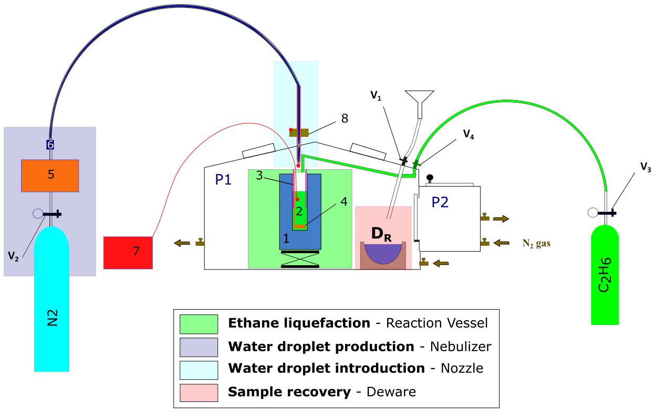

Slide 6
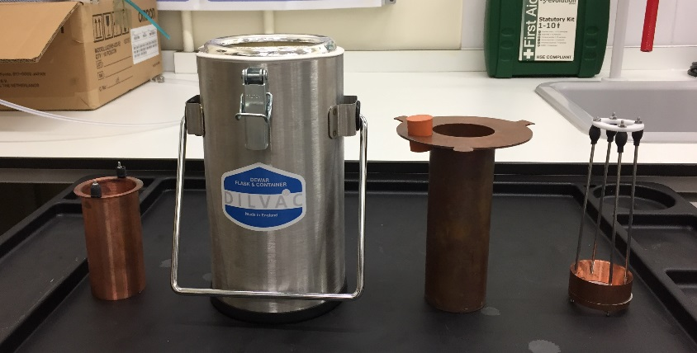
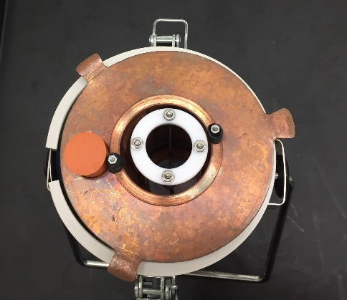
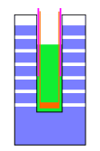
a
b
3
1
2
4
c
2. Secondary Cryogen
liquid C₂H₆ (89.7 – 184.4 K)
3. Frost shield
4. PTFE 1 µm membrane
1. Primary Cryogen
liquid N₂ (77 K)

Slide 7
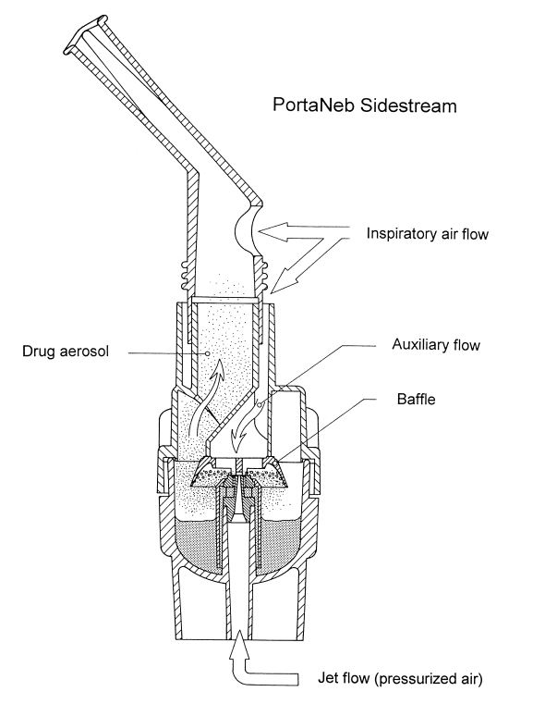
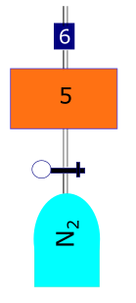
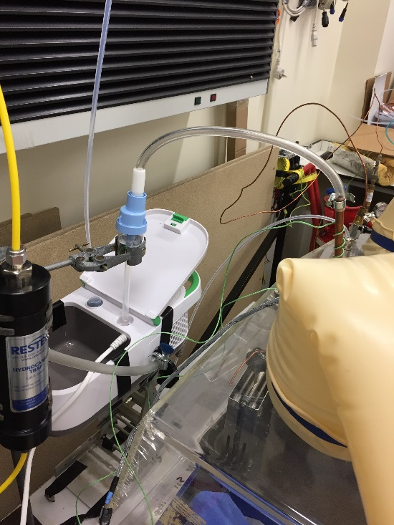
a)
b)
c)
Mouth-piece
O-ring
Water
reservoir (6)
N₂ gas
connection
Compressor (5)

Slide 8
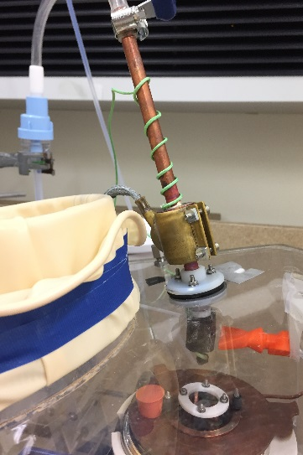
a)
b)
T₂
6
8
5
T₁
N₂ gas inlet

Slide 9
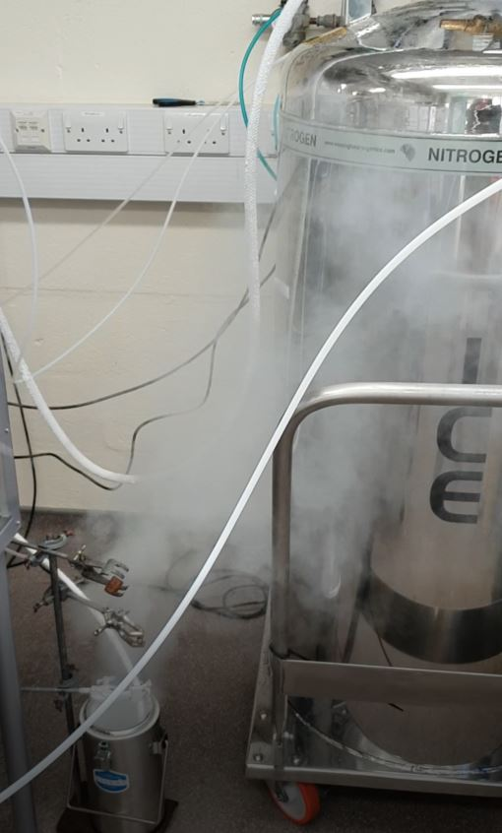
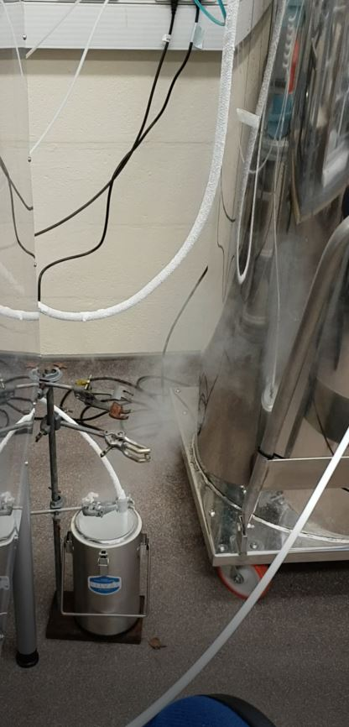
a)
b)
1 m
30 cm

Slide 10
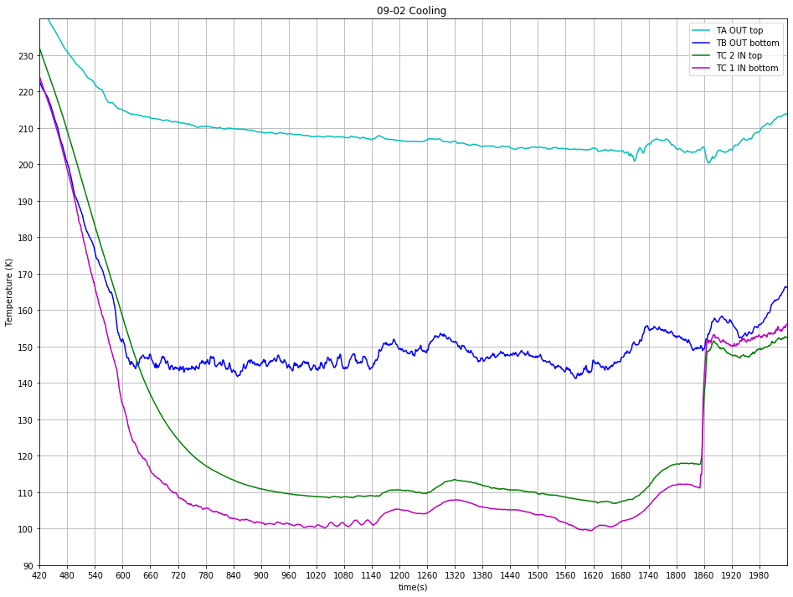
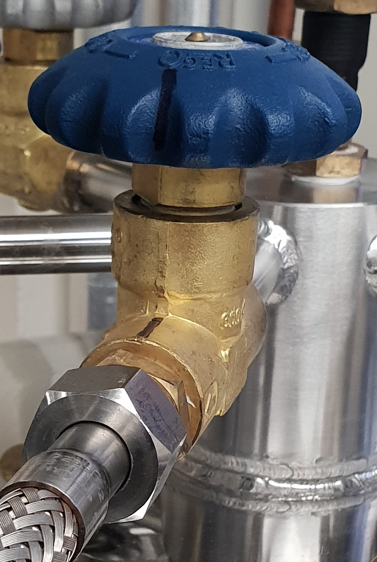
a)
b)
Tc 1 IN bottom
Tc 2 IN top
Tc A OUT top
Tc B OUT bottom
N2 flow adjustment period
TB set at 150 K
1 Step (1C)
Ethane introduction

Slide 11
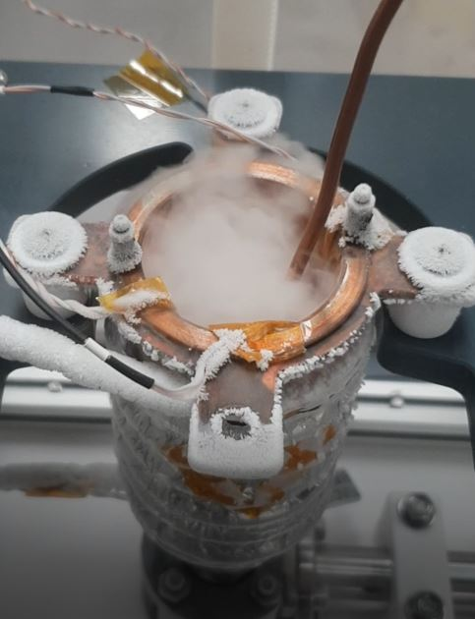
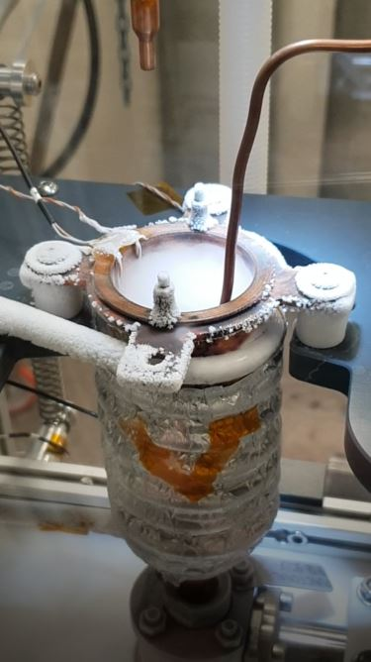
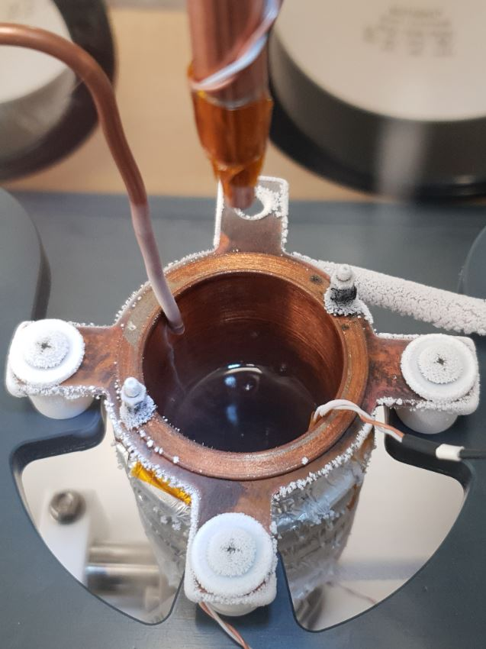
a)
b)
c)

Slide 12
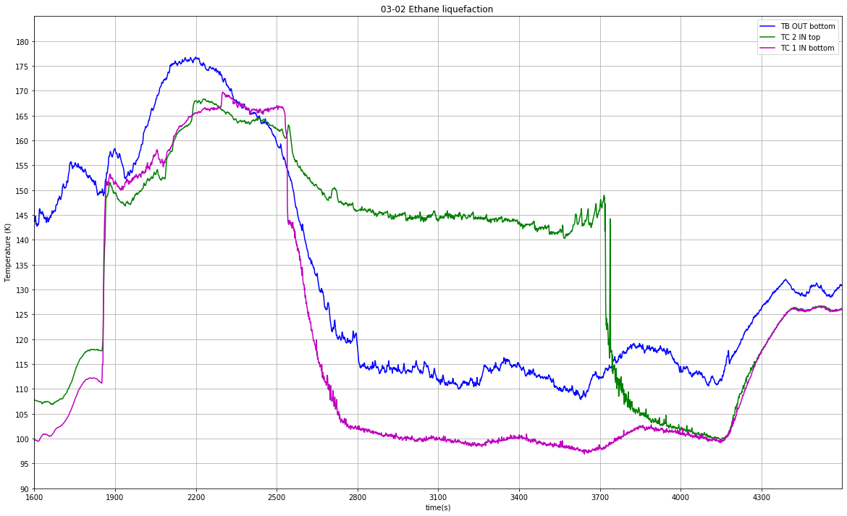
Tc 1 IN bottom
Tc 2 IN top
Tc B OUT bottom
TB set at 130 K
TC1 submerged
TC2 submerged
Ethane flow started

Slide 13
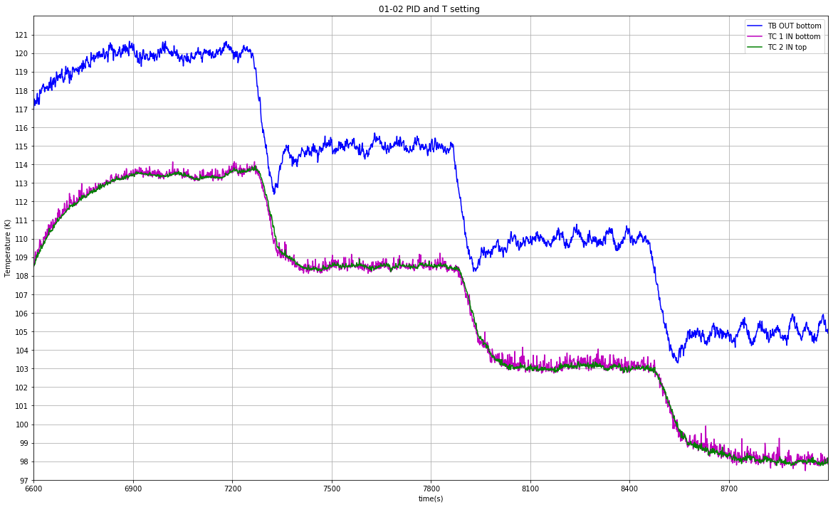
Tc 1 IN bottom
Tc 2 IN top
Tc B OUT bottom

Slide 14
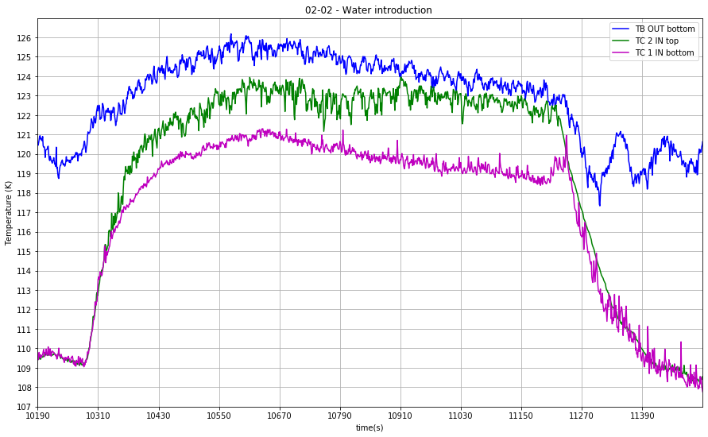
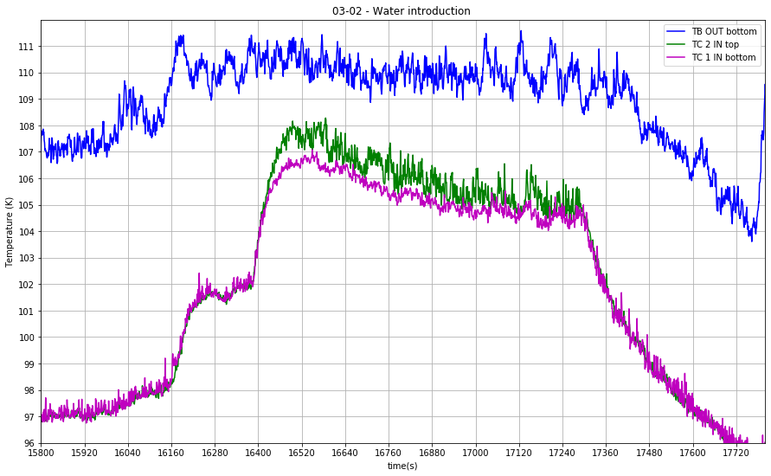
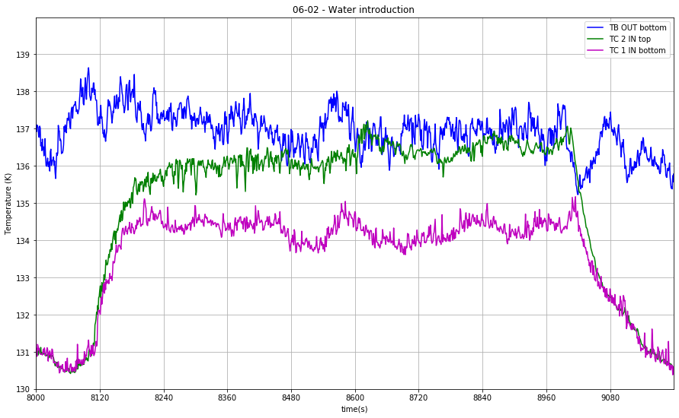
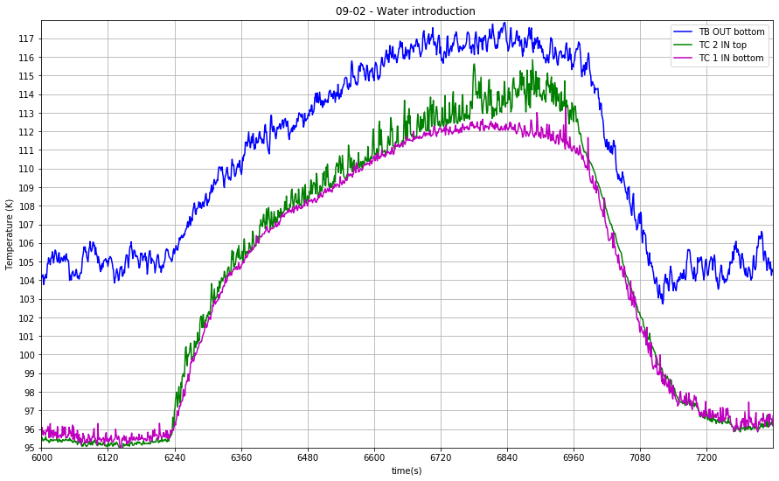
a)
b)
c)
d)

Slide 15
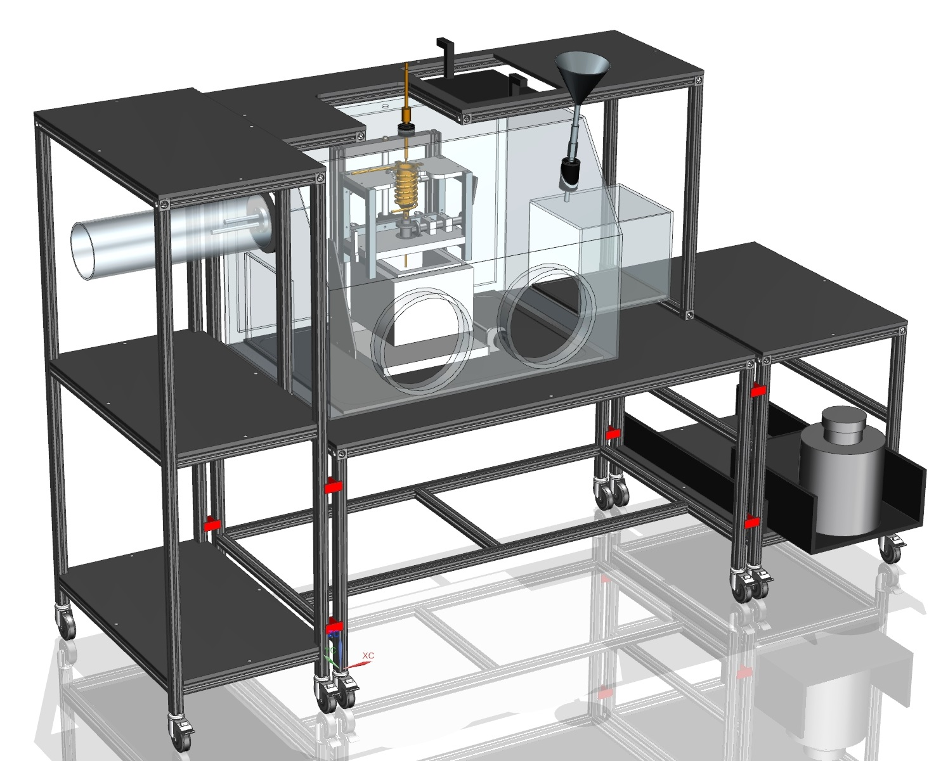
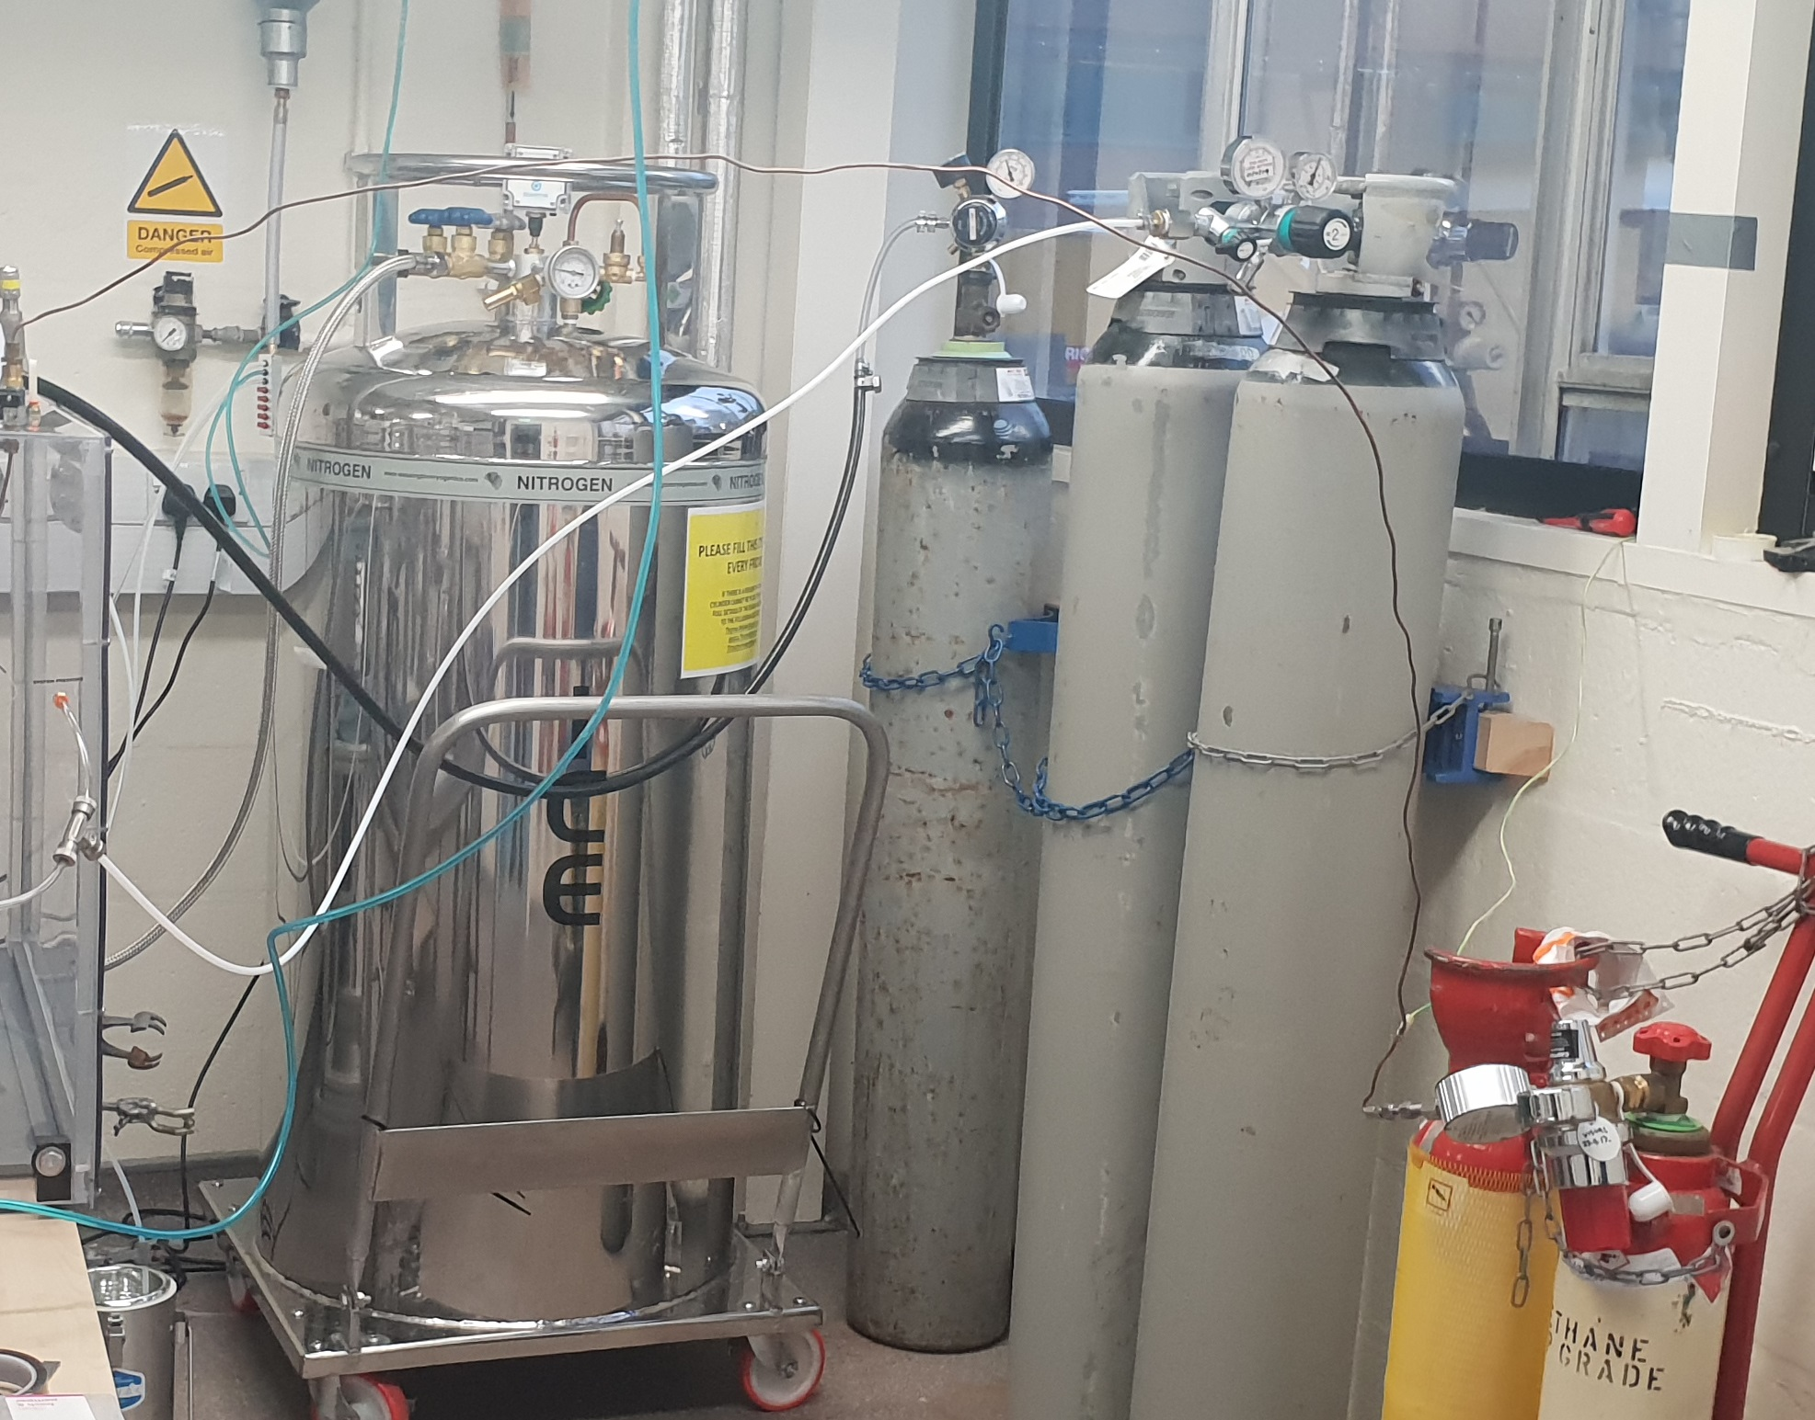
a)
b)
Nebuliser
PID
Sample extraction
Area
1
3
2
Computer
5
Cryo-shipping
Dewar
4

